Slide 1


LPG/LNG

Slide 2
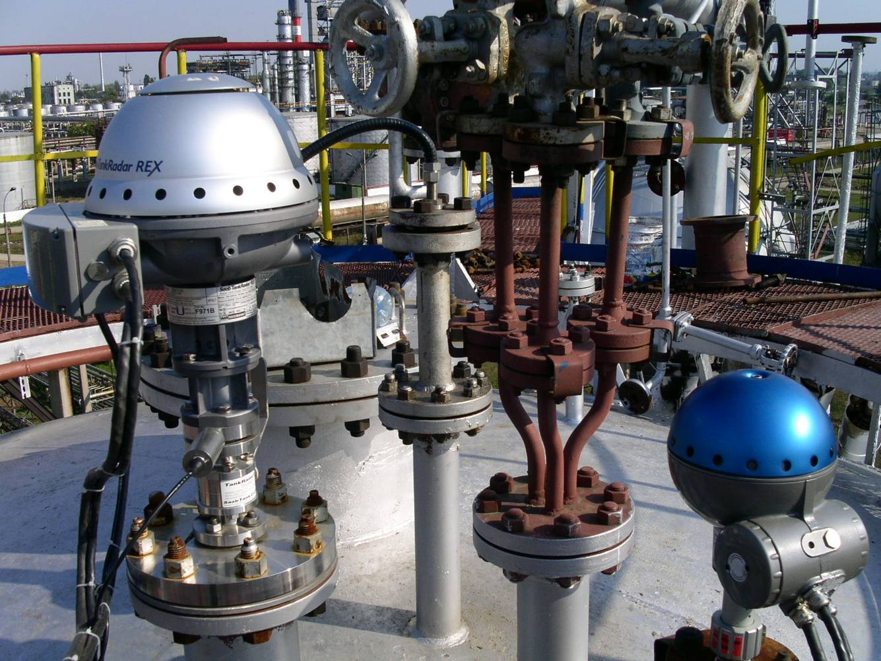
Lessons goal
To know
Measuring on LPG/LNG
Different parts for a LPG/LNG system
Installation procedure
Calibration
Verification

Slide 3
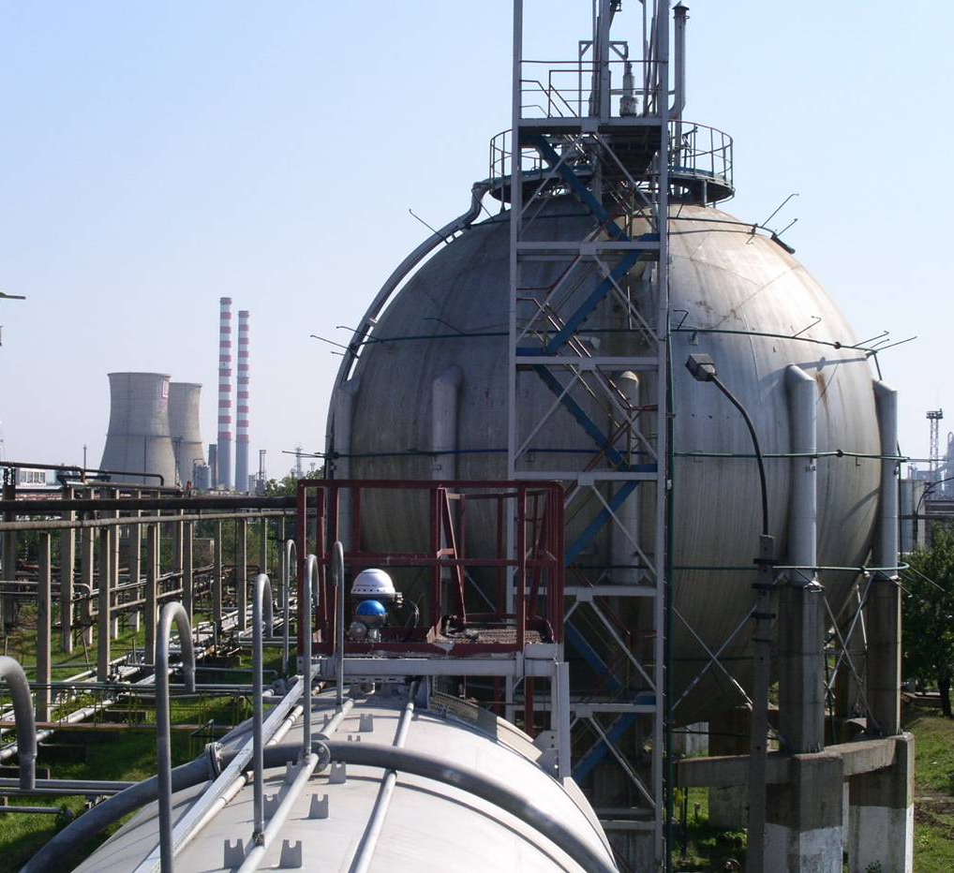
Common Tank types
Sphere
Bullet

Slide 4
Measuring on LPG/LNG
What is LPG - Liquefied Petroleum Gas ?
”A mixture of butane, propane and other light hydrocarbons derived from refining crude oil. At normal temperatures, it is a gas, but it can be cooled or subjected to pressure to facilitate storage and transportation.” According to ConocoPhillips .
What is LNG - Liquefied Natural Gas?
“Liquefied natural gas, or LNG, is natural gas in its liquid form. When natural gas is cooled to minus 259 degrees Fahrenheit (-161 degrees Celsius), it becomes a clear, colorless, odorless liquid. LNG is neither corrosive or toxic. Natural gas is primarily methane, with low concentrations of other hydrocarbons, water, carbon dioxide, nitrogen, oxygen and some sulfur compounds. During the process known as liquefaction, natural gas is cooled below its boiling point, removing most of these compounds. The remaining natural gas is primarily methane with only small amounts of other hydrocarbons. LNG weighs less than half the weight of water so it will float if spilled on water.” According to CA Energy Commission.

Slide 5
Measuring on LPG/LNG
What happens when a Tank is filled/emptied?
After a rapid filling or emptying of the tank – or after a rapid change in temperature – it will take some time before a state of equilibrium is reached. It can take everything from a few hours to a day. By then the temperature in the liquid should be equal to the one in the vapor and the pressure should be stable.
“Equilibrium”, state of balance. In thermodynamics, two bodies placed in contact with each other are said to be in thermal equilibrium when, after a sufficient length of time, their temperatures are equal.

Slide 6
Why Correction?
Vapour and its density:
Will affect the speed of the radar beam
Higher pressure and Lower temperature will decrease the speed of microwaves
Result is inaccurate measurement
Compensation
TR REX use the actual vapour pressure and vapour temperature for automatic compensation.
Result is accurate measurement
Different calculation methods must be used depending on the gas, or mix of gases, in the vessel:
LPG: usually Propane, Butane or a mix of them
LNG: Methane

Slide 7
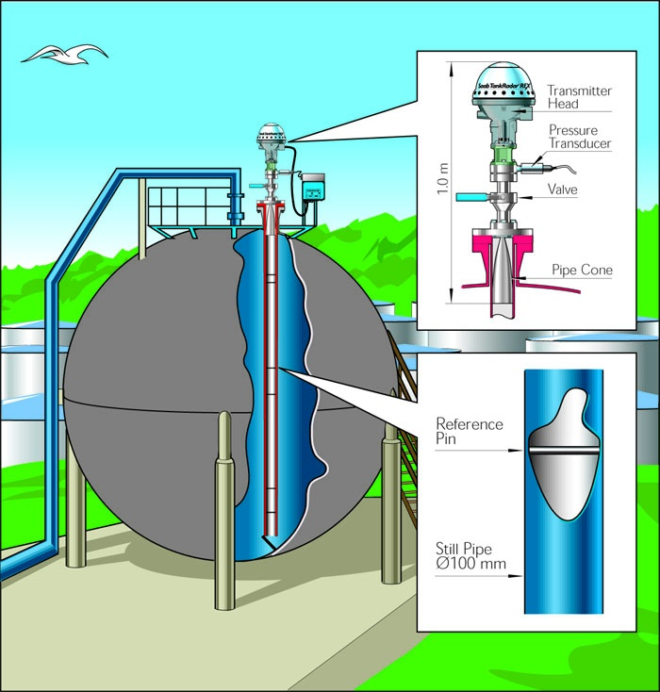
LPG/LNG gauge - RTG 3960
Measuring range.
Vessels up to 25 Bar
0.5 - 60 meters from cone end
Integrated pressure sensor.
Ball valve for safety.
Verification during normal operation.
Custody transfer accuracy.
No maintenance.
Only cone antenna inside tank.
Explosion proof.

Slide 8
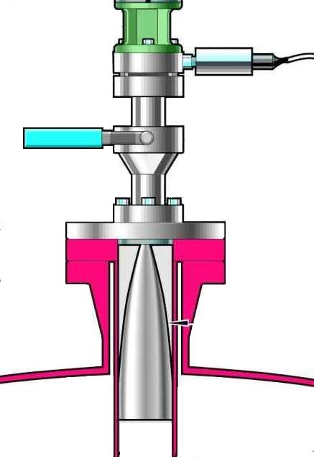
LPG/LNG gauge - pressure parts
Pressure sensor (vapor)
Note: Not installed in LNG
Handle for verification mode
Pressure sealing (quartz window)
Ball Valve
Flange 150, 300 or 600 psi
LPG Antenna, Stainless Steel 4” sch 10 & 40 + 100mm

Slide 9
LPG/LNG gauge - RTG 3960
Why a Ball valve?
A LPG tank contains a gas with high pressure
The fireproof ball-valve makes it possible to seal the tank in cases like when the Pressure sensor needs to be replaced

Slide 10
LPG/LNG gauge - pressure tested
These parts are mounted together
and pressure tested at the
factory and should
not be taken apart at any time.
The pressure transmitter can be exchanged.
Notes:
Får man byta tryckgivare utan provtryckning?

Slide 11
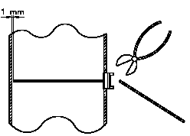
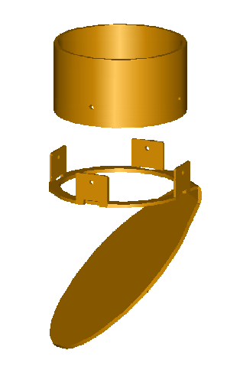
LPG/LNG gauge - still pipe
Deflection Plate
Including calibration ring

Slide 12
LPG/LNG gauge - RTG 3960
Why a Calibration ring/Deflection plate?
Calibration ring is used for calibrating the Gauge during start-up of vessel
Requires an empty tank
Calibration ring gives an echo when vessel is empty
Deflection plate ’hides’ the strong bottom echo from the empty vessel
Deflection plate also enables the gauge to measure the liquid level close to empty vessel.
Why Reference pin?
Possible to verify gauge measurement without opening vessel
’Hand-dip’ not possible.....

Slide 13
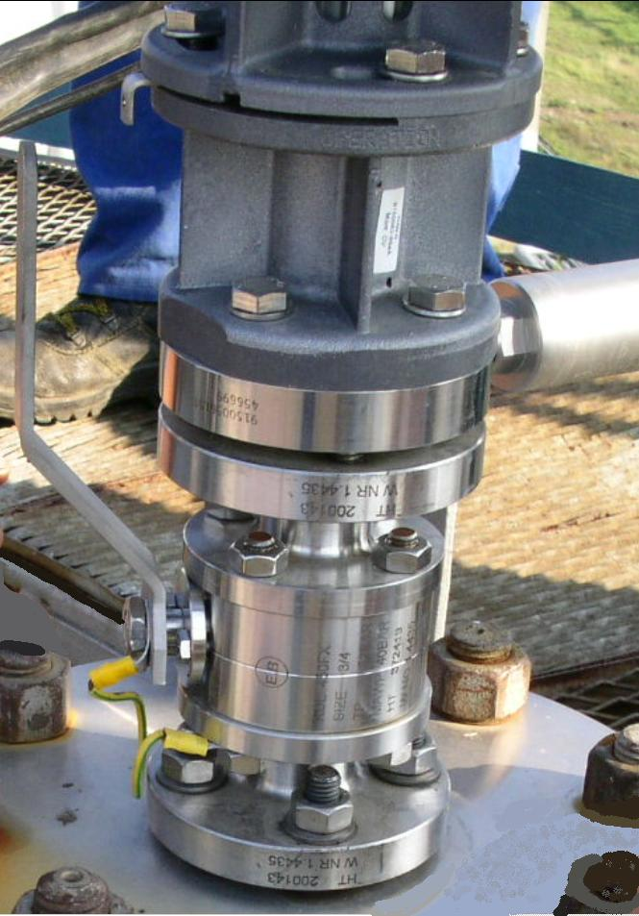
Reference Pins – how does it work?
Normally a still pipe in a LPG tank is clean
No deposit and not rusty.
Because of that it is not necessary to have the ‘Low loss mode’.
RTG 3960 uses the Linear Mode
A mechanical device change the direction 90˚
In “TEST” – mode pins can be verified
In “OPERATION” – mode pins are invisible
The pins shall not be used for “calibration”.
Accuracy of pin up to 20 mm off from electrical distance.

Slide 14
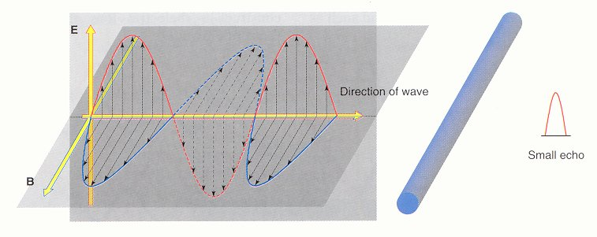
Reference Pins – Operation mode
“Handle” in OPERATION mode
The reference pin is perpendicular to the electrical field and almost invisible for the radar.
The echo from the pin is approximately 50mV in this position and doesn’t influence the level measurement.
Reference pin.

Slide 15
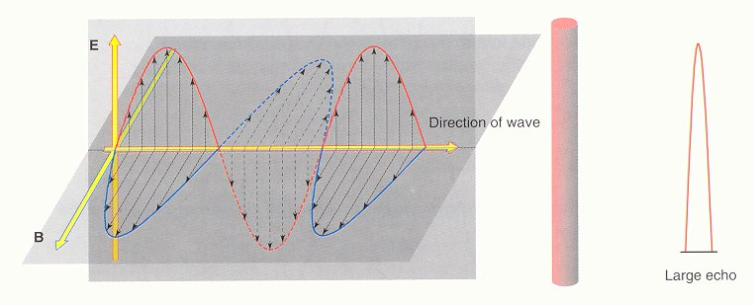
Reference Pins – TEST mode
“Handle” in TEST mode
The reference pin is in the same direction as the electrical field.
An electrical field is also built up around the pin and it will become visible for the radar.
The echo from the pin is normally > 800mV in this position.
When you move the handle to TEST position, the level value will also change a little bit but it will be back to the calibrated value when the handle is back in operation mode
Reference pin.

Slide 16
Mechanical Mounting
Following documents are available:
’Requirements on Still pipe and its installation’, document 9150072-988
’Mechanical Installation Drawing’, 9150072-924
’Mechanical Installation Drawing’, 9150072-925
’Installation Instruction Reflector Ring’, 9150071-651
TR REX, ’Installation Manual’ Edition 2; see page 3-6 and 10-38 -> 10-46
Specification on still pipes suitable for 3960 cones
4” sch 10=> Inner diameter is 114,30 –(2 x 3,05)=108,2 mm
4” sch 40=> Inner diameter is 114,30 –(2 x 6,02)=102,3 mm

Slide 17
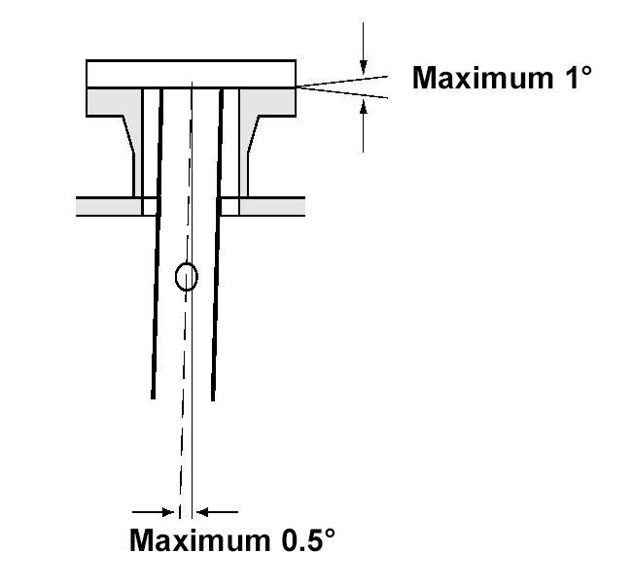
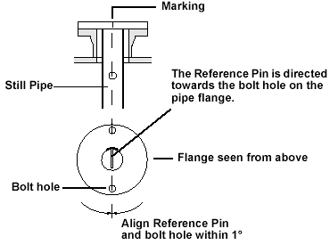
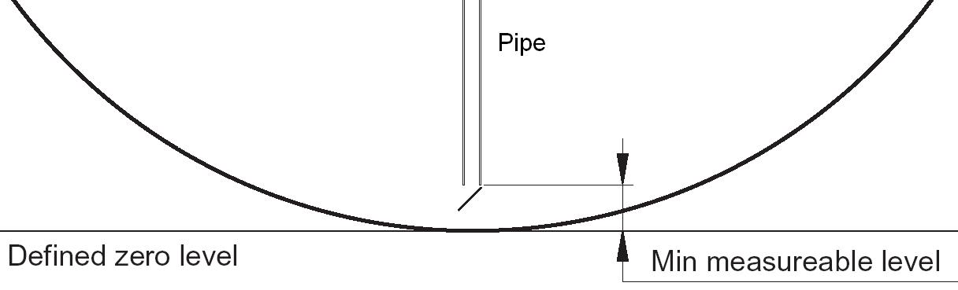
Installation
Mechanical
Still pipe(see doc. 9150 072-988)
Clean, straight and within 0.5º from plumb line
RTG, including valve
Check bolts, gaskets, pressure tightness and rating on flange.
Measurements
Pin position
Determine where the “zero” point is in the tank.
The RTG can never measure outside the still pipe
Positions of pressure transmitters.

Slide 18
LPG Configuration
Following documents are available:
”Technical Specification 3960”
Technical Description Edition 2, Page 20-21
”Installing an LPG/LNG Tank Gauge”
WinSetup Edition 2, page 119-125
WinSetup Edition 3, page 3-140-147

Slide 19
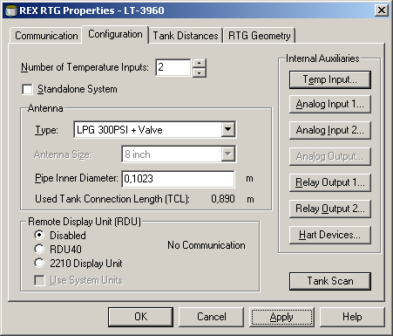
Configuration
Configure the REX using standard wizard
Antenna will be “LPG……..” or “User def. Linear Pipe”
(Check type of antenna and flange!)
Set correct “Pipe Inner Diameter”

Slide 20
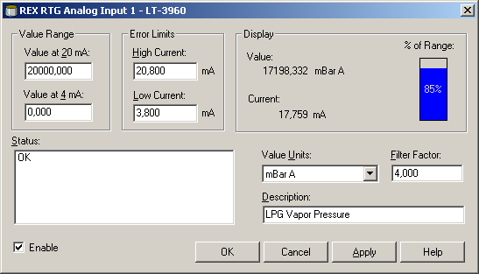
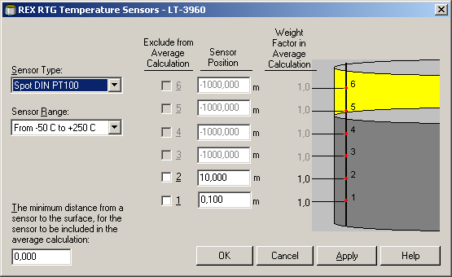
Configuration
Configure Pressure Sensors
Select appropriate Input type, Analog or HART
Make sure Range and Unit is correct (check Pressure Transmitter!)
Configure Temperature Sensors
Select appropriate input type, Rex or DAU
Enter “sensor position”

Slide 21
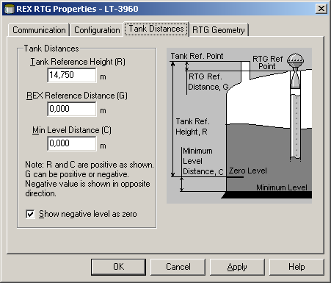
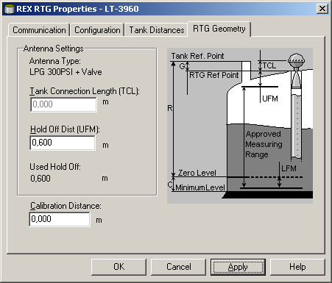
Configuration
Tankheight
Set ”R-distance” = Tank Zero Point
”Holdoff Distance” may have to be adjusted

Slide 22
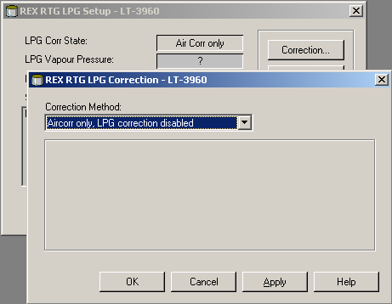
Configuration
In ‘LPG Setup’
Set Correction method to “Air Corr only”

Slide 23
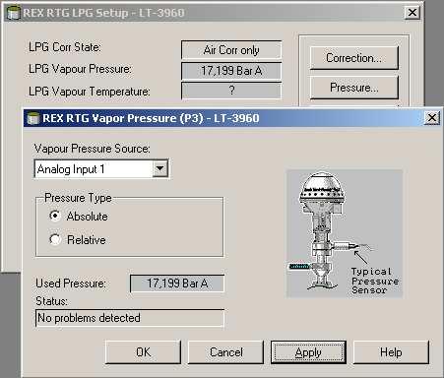
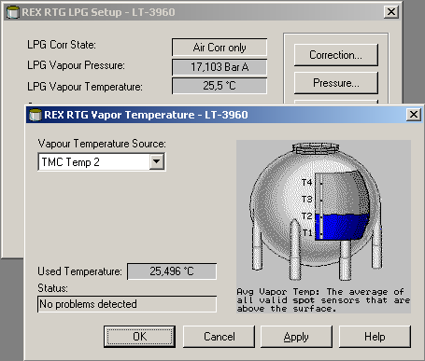
Configuration
In LPG Setup
Select Vapour Pressure Source
Select correct Pressure Type
Select Vapour Temperature Source
Select Highest Sensor for Vapour Temperature

Slide 24
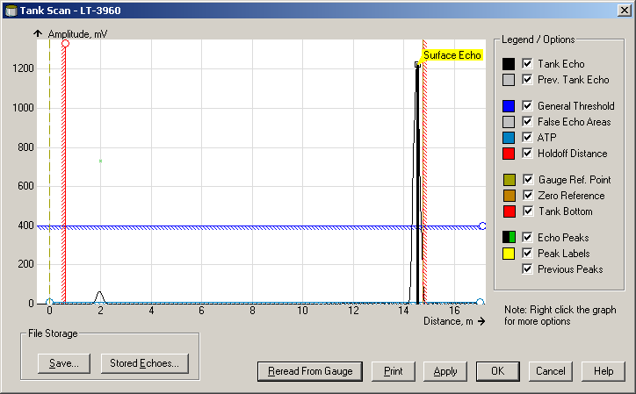
Configuration
Calibrate (with empty tank and handle in OPERATION position)
Calibrate the Rex against the calibration ring.(Length of pipe = reference!)
After calibration, REX will show Level = Min measurable Level (distance between Tank Zero point and end of Still pipe)
If required – run calibration for pipe with water.
Setting calibration for full tank range (scale factor)

Slide 25
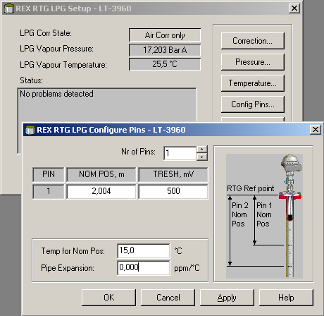
Configuration
In ‘LPG Setup’
Set Nominal pin-position (the measured mechanical position)

Slide 26
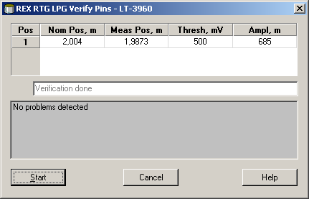
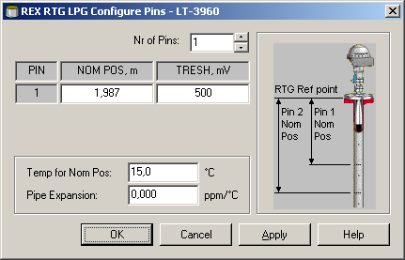

Configuration
Configure LPG
Change the handle to “TEST”
Verify “electrical” pin – position
This will be the Nom. position used in the future.

Slide 27
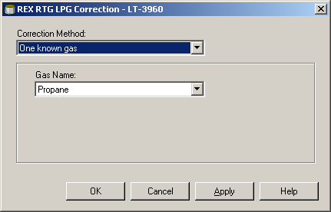
Configuration –Don’t forget……..
configuration cont…
Change the handle back to “OPERATION”
…….Final
Change “Correction method” to corresponding content in the Tank.
The Tank is now ready to be taken into operation
Next, How to make a Pin-verification during operation?

Slide 28
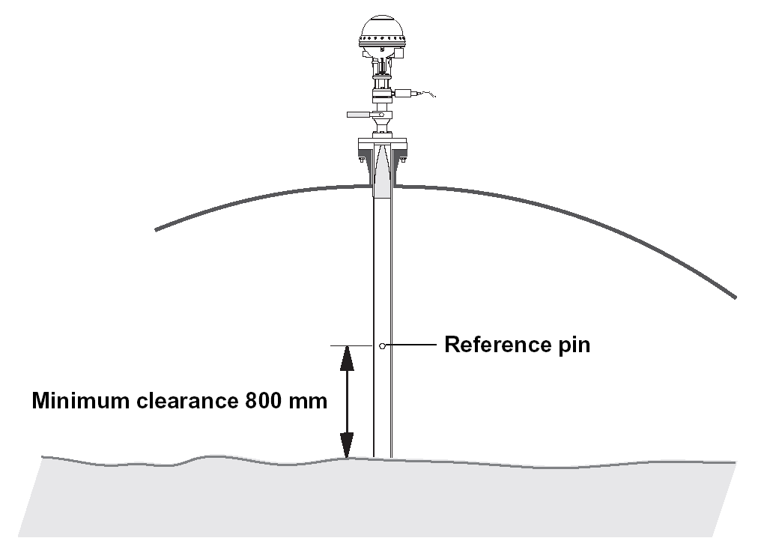
LPG Verification
Verification during normal operation
Makes it possible to verify the gauge during full operation.
Verifies that the gauge displayed Level is correct
Verifies that “vapour compensation” is working
A pin can be verified if the actual level is more than 800 mm below the pin-position.

Slide 29
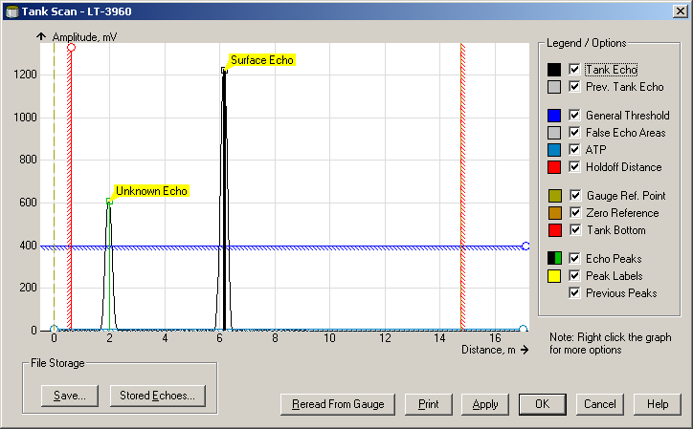
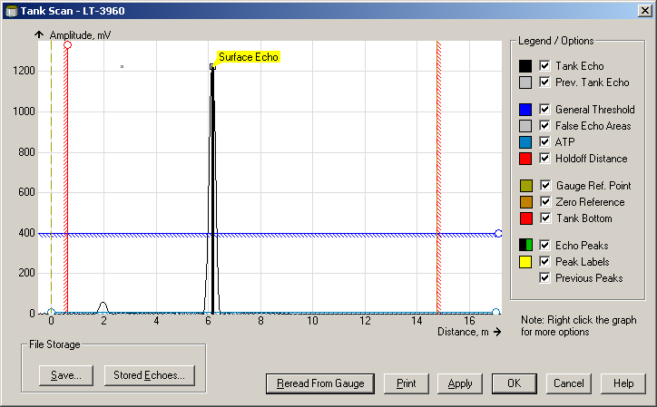
LPG Verification
Pin-verification during full tank operation!
Set handle to “TEST”.
Level might change
Start “Verify pins”
The pins should be found with in 20 mm form the nominal (electric) distance.
It can be necessary to change pin threshold.
Change the handle back to “OPERATION”
No “calibration” against pins!

Slide 30
LPG/LNG
Features in 5900S

Slide 31
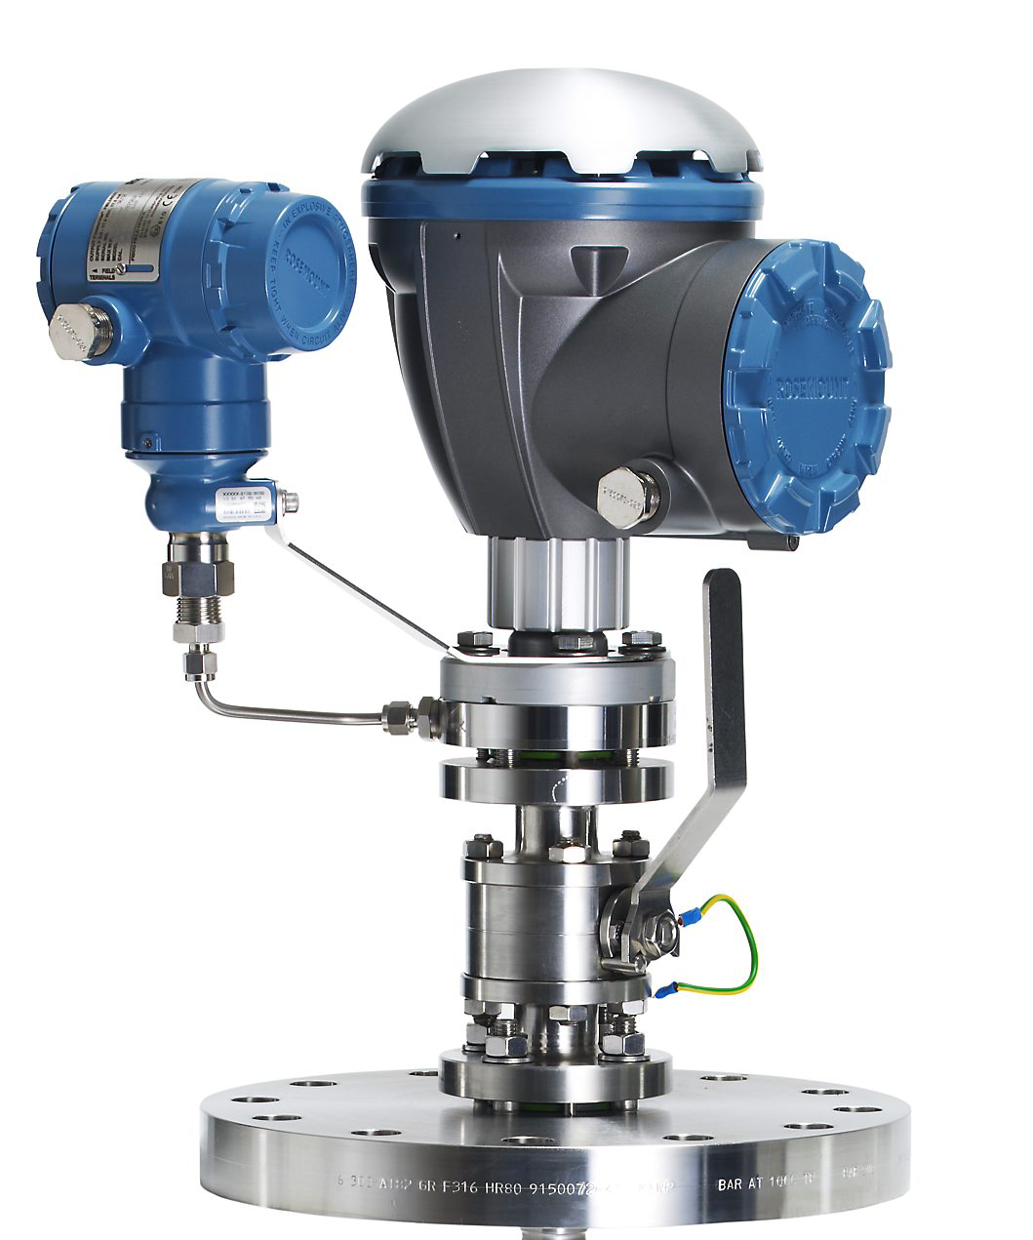
5900S pressure parts
Pressure sensor (vapor)
Pressure sealing (quartz window)
Ball Valve
Flange 150, 300 or 600 psi

Slide 32
5900S vs REX 3960
Configuration of Antenna is identical to Rex
Calibration of 5900S is identical to Rex
Initial ’Calibration’ of Ref pin position is identical to Rex
Configuration of ”LPG Setup” is identical to Rex
Configuration of Pressure and Temperature Source is different from Rex
this is done in the 2410 Tank Hub

Slide 33
5900S vs REX 3960
5900S
Measuring on the reference pin all the time
Position of pin 90 degrees compared to holes in pipe
Length of pin is 50% of pipe diameter
New 2051 pressure transmitter
Rex
Test Mode: measuring the reference pin
Operation Mode: reference pin is ”invisible”
Position of pin aligned with holes in pipe

Slide 34
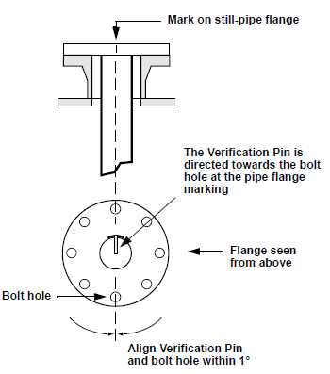
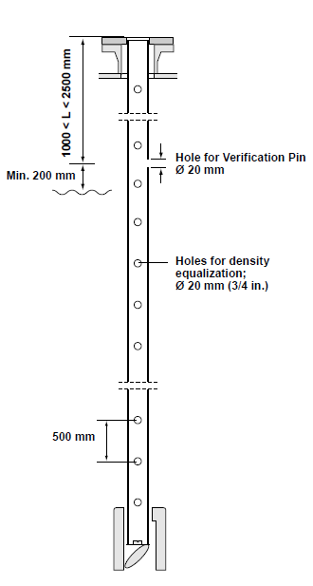
5900S Reference Pin
Install the still-pipe according to mechanical installation drawing 9240041-910
The direction of the Verification Pin is indicated by marks on the still-pipe flange and the closing
The Verification Pin should be placed at a position of 2500 mm below the flange
There must be a minimum distance of 200 mm between the Verification Pin and the maximum product level
In order to fulfill this requirement, the Verification Pin may be mounted higher, up to 1000 mm below the flange

Slide 35
5900 S Reference Pin
Continuous measurement on pin
The reference pin is in the same direction as the electrical field.
An electrical field is also built up around the pin and it will become visible for the radar.
The echo from the pin is normally > 600mV in this position.
Length of pin is “Pipe diameter / 2” to avoid too strong signal from pin
Reference pin.

Slide 36
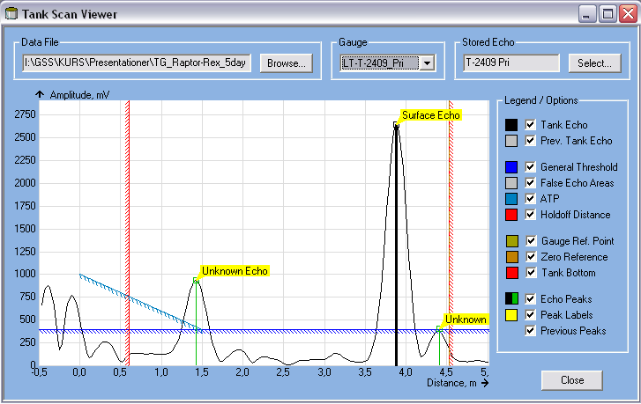
5900S pin verification
Continouos verification of pin with tank in operation
Ref.pin always visible

Slide 37
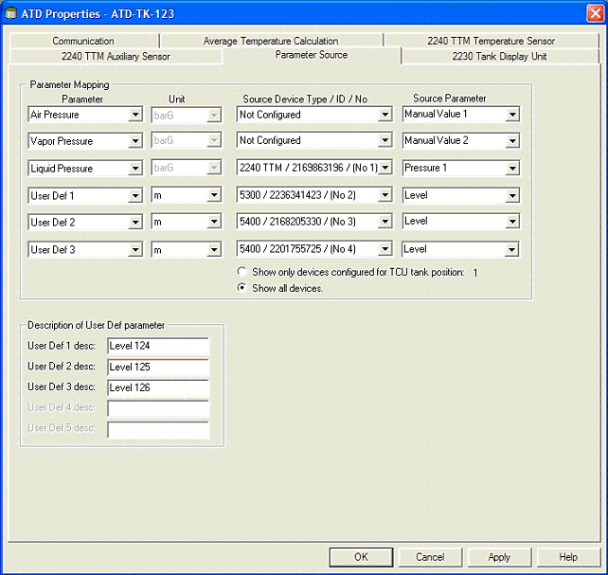
5900S Temp and Pressure
Pressure Sensor Properties – Parameters Source
Map tank parameters to source devices connected to the tankbus
If 2240 is used, vapor temp is automatically mapped to the avg temp of all spot sensors above product surface
Possible to map a specific sensor in this window
Notes:
When a Rosemount 2240 tank temperature multiplexer is used, the
vapor temperature is automatically mapped to the average temperature
of all spot sensors above the product surface. In case you like to map a
specific sensor, open the ATD Properties window and select the
Parameter Source tab to choose the desired temperature source device.

Slide 38
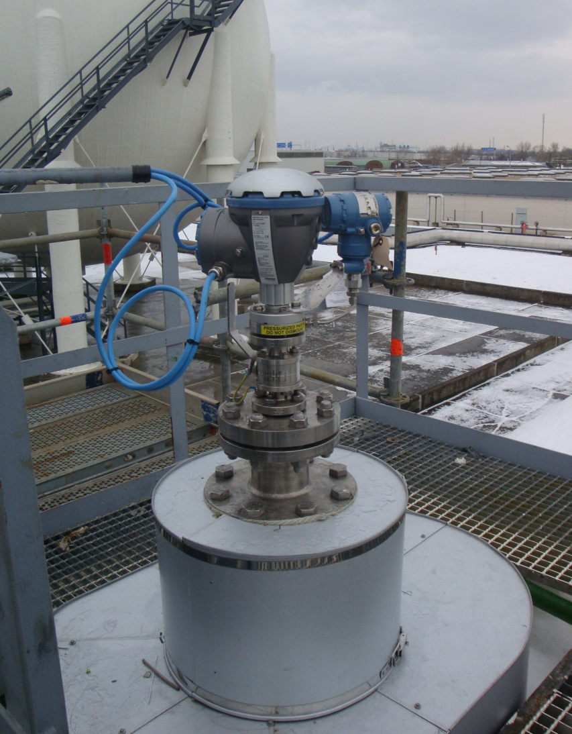
Installation Austria

